Slide 1

Predicting Diabetes Using Machine Learning
Presented by:
Damián
Dei
Theophilus
Ugo

Slide 2
Project Overview
This project aims to predict whether a patient is likely to develop diabetes based on medical information.
We approached this as a binary classification problem using supervised learning.
The objective is to assist healthcare providers in early detection of diabetes risk, which can improve preventive care.
A high-recall model can help avoid overlooking high-risk patients.

Slide 3
Data Selection and Preparation
Dataset: Pima Indians Diabetes Dataset (768 patient records)
Features: Medical and demographic variables such as Glucose, BMI, Insulin, SkinThickness, and Age
Target variable: Outcome (1 = diabetic, 0 = non-diabetic)
Data Cleaning:
Replaced impossible zero values in medical columns with NaN
Imputed missing values with the median
One-hot encoded categorical features (AgeGroup, BMICategory)
Standardized numeric features with StandardScaler
Handled class imbalance by assigning class_weight='balanced'

Slide 4

Feature Engineering and Selection
Created new features:
AgeGroup: Young (<30), Middle (<50), Old (≥50)
BMICategory: Based on WHO guidelines (e.g. Normal, Obese)
Glucose_BMI: A new interaction feature multiplying Glucose and BMI
Purpose: Capture complex risk patterns related to weight, age, and glucose levels
Challenge: Maintaining numerical compatibility for modeling

Slide 5
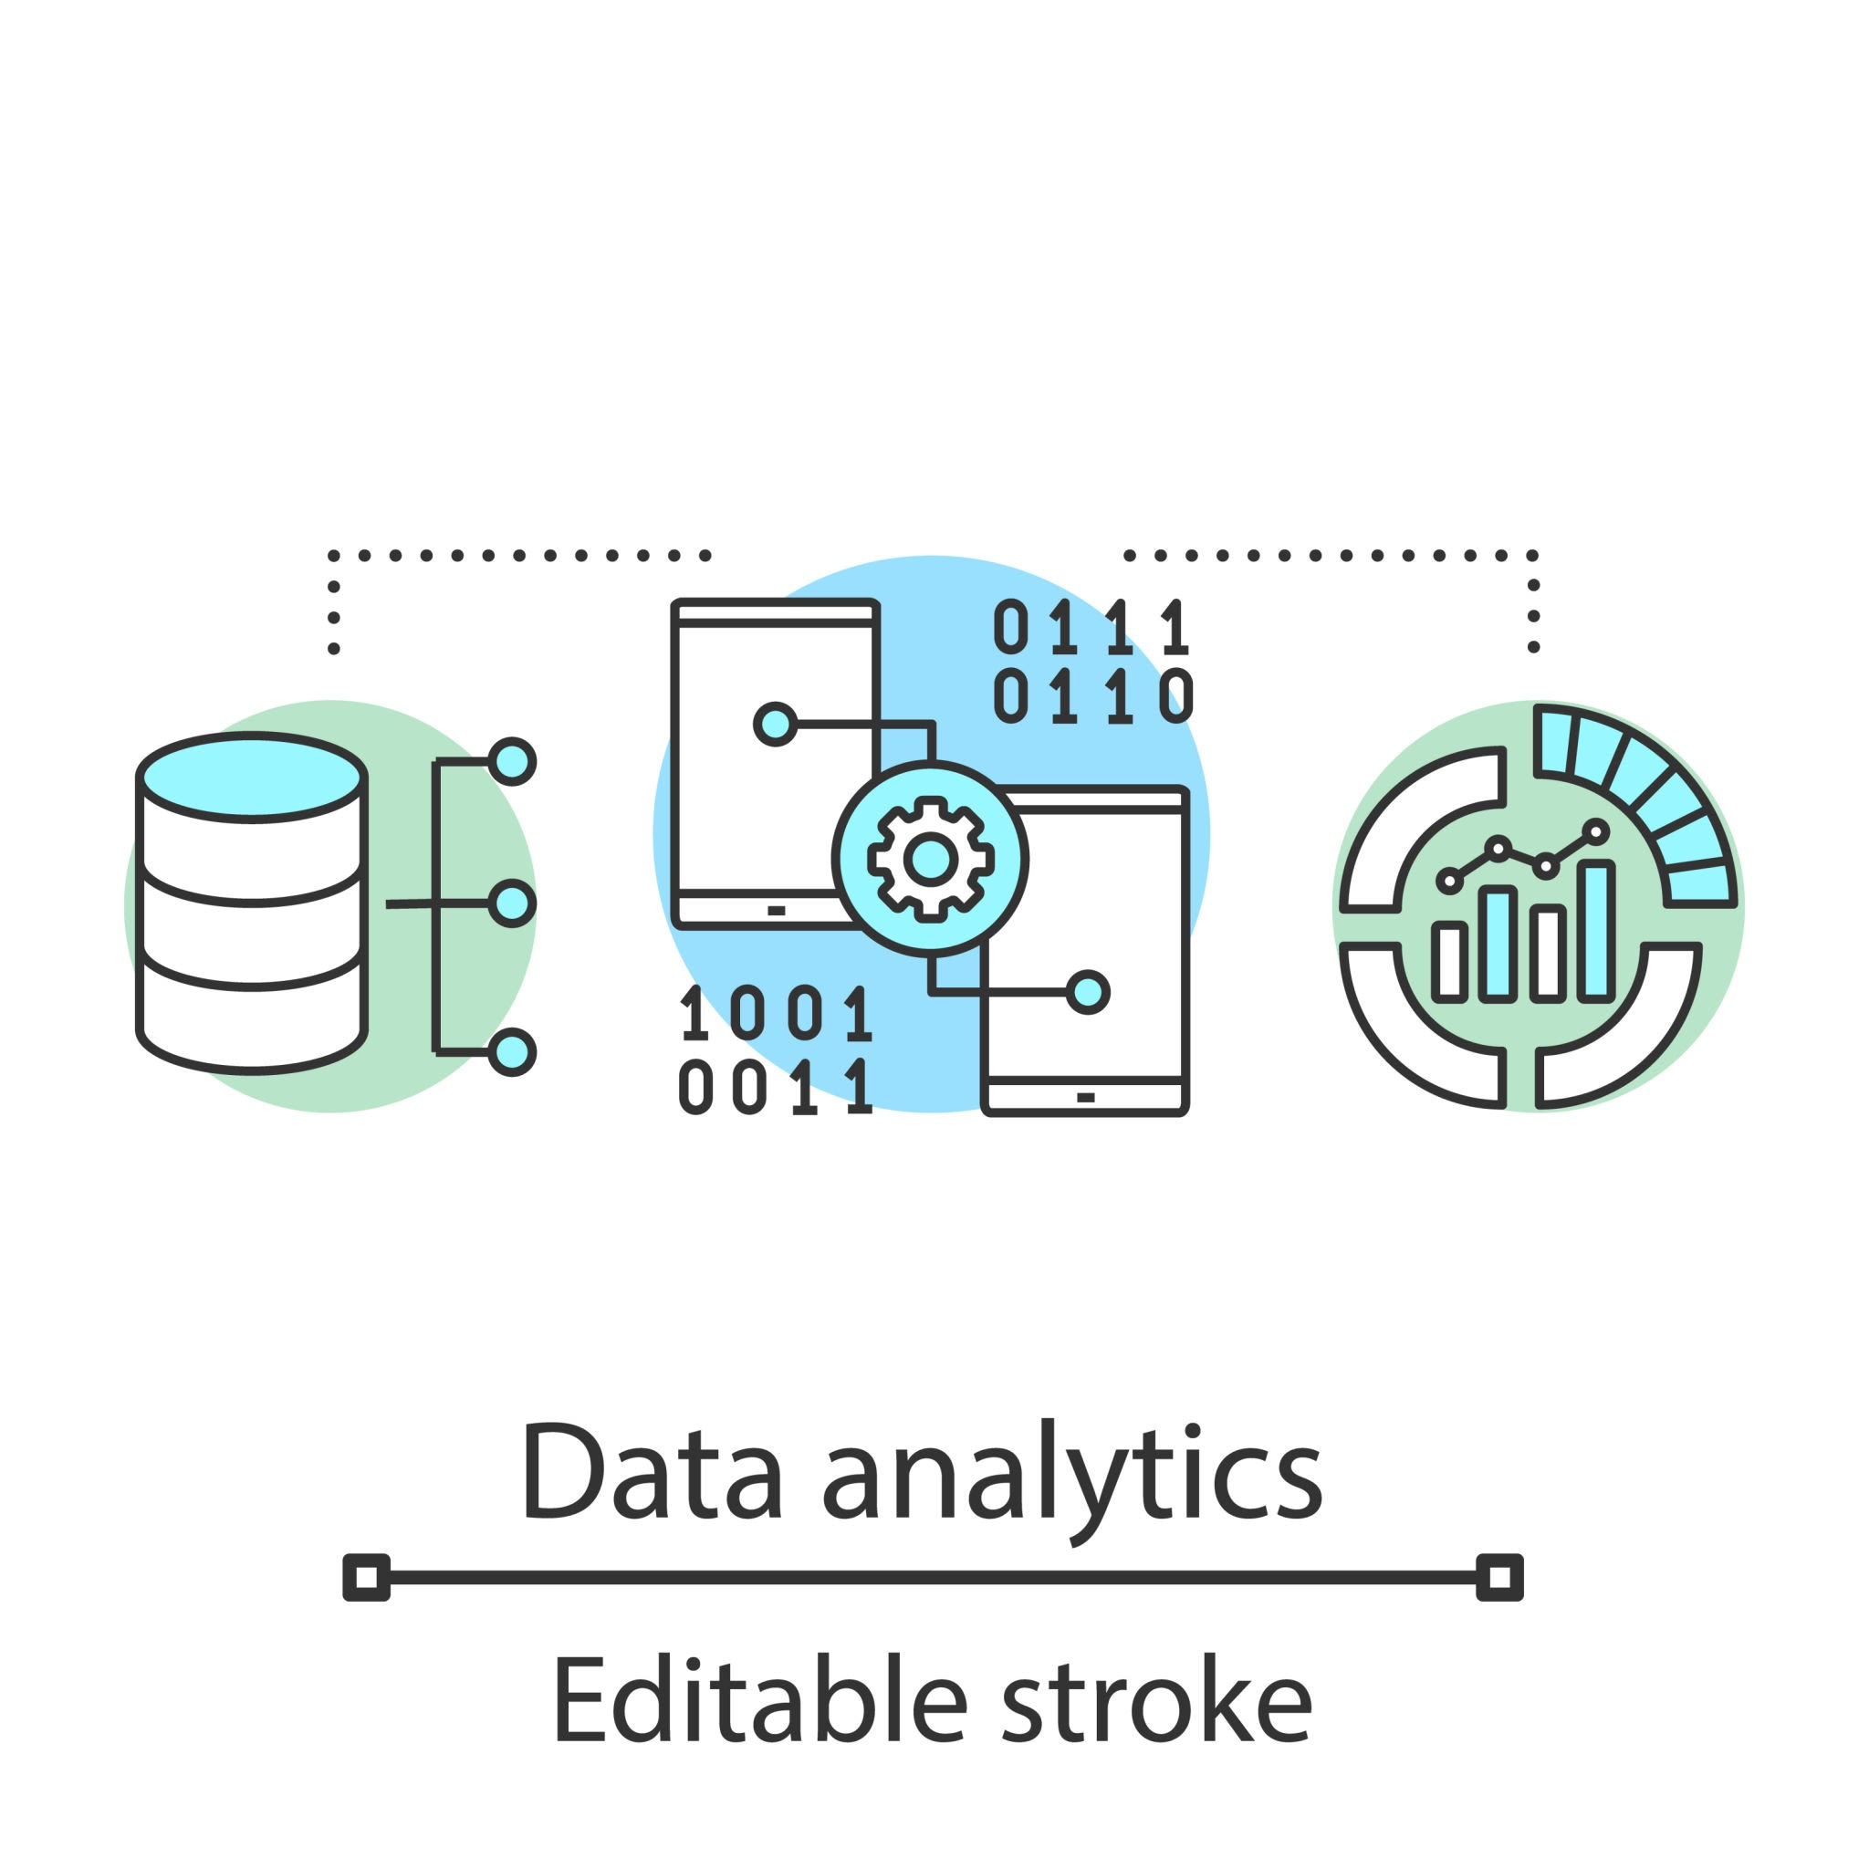
Model Building and Evaluation
Models Used:
Logistic Regression (baseline)
K-Nearest Neighbors (KNN)
Random Forest Classifier
Evaluation Metrics:
Accuracy, Precision, Recall, F1 Score
Focus on Recall, as detecting diabetic cases is most critical
Validation Method: train_test_split (80/20, stratified), GridSearchCV with 5-fold cross-validation

Slide 6
Hyperparameter Tuning and Optimization
Technique: GridSearchCV with scoring set to f1
KNN tuning: Optimized n_neighbors (best = 7)
Random Forest tuning:
n_estimators: 100
max_depth: 10
min_samples_split: 10
Outcome: Improved F1 Score and Recall, particularly in Random Forest

Slide 7
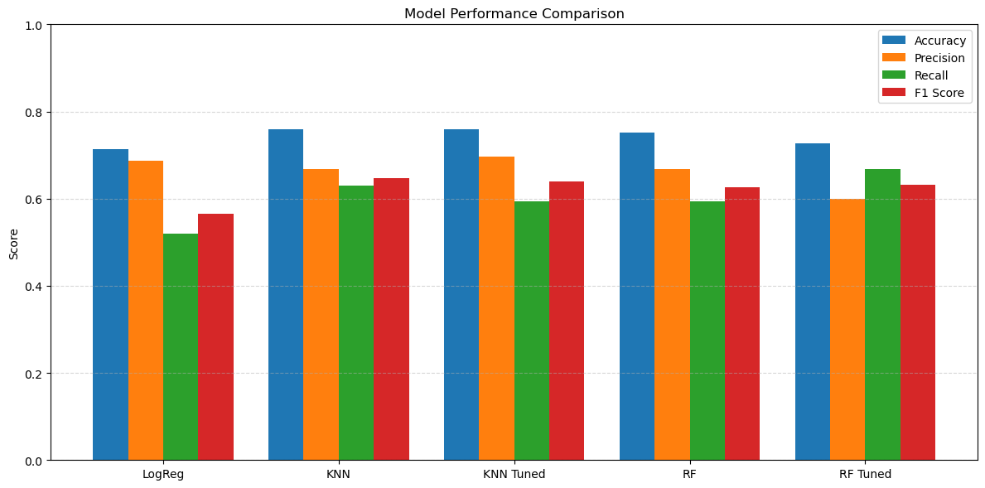
Key Findings / Part 1

Slide 8
Key Findings / Part 2
Best model
Random forest (tuned) best recall (66.7%)
Most Informative Features
-Glucose -BMI
-Age -Glucose_BMI
Visual anlysis
Confusion Matrix showed fewer false negatives in tuned RF

Slide 9
Real World application and impact
Use Case: Assist clinics and hospitals in flagging high-risk patients
Can be embedded in patient intake systems to prioritize screenings
Impact: Improve early detection and preventive treatment.
Limitations: Based on a specific population (Pima Indian women), not generalizable without further validation
- Ethical caution: Should not replace a doctor’s diagnosis

Slide 10
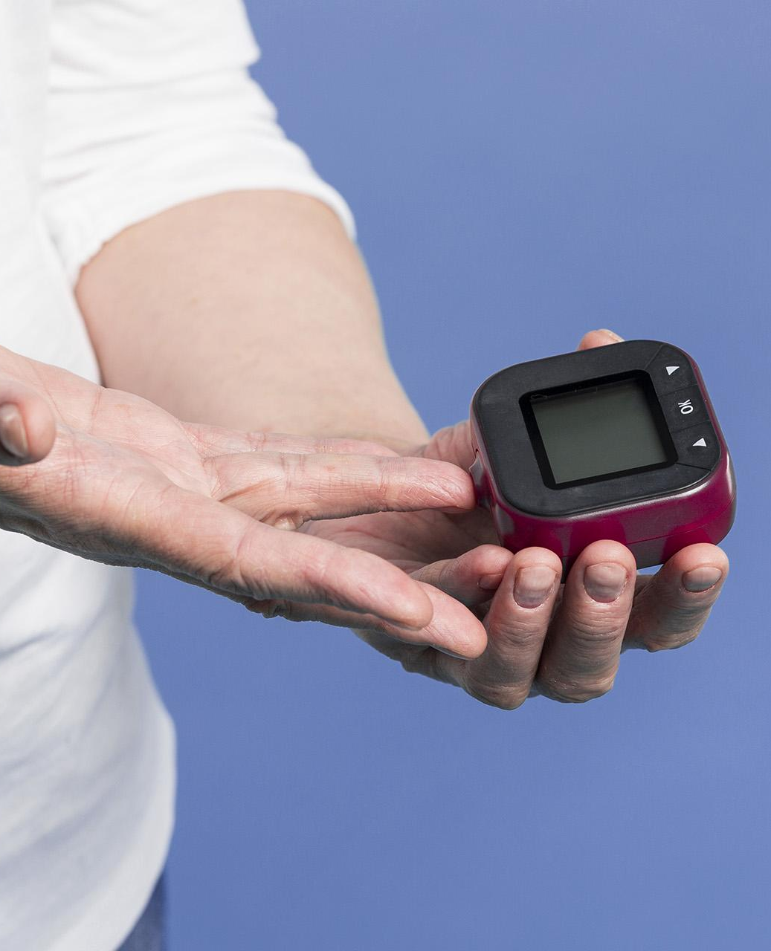
CHALLENGE & LEARNINGS
Understanding data imbalance and selecting the right metrics
Choosing the best model while balancing overfitting and recall
Impact: Improve early detection and preventive treatment
Limitations: Based on a specific population (Pima Indian women), not generalizable without further validation
Ethical caution: Should not replace a doctor’s diagnosis

Slide 11

RELEVANT CONCLUSIONS
Incorporate advanced models (e.g. XGBoost, LightGBM)
Try SMOTE or ADASYN for oversampling
Perform feature selection using SelectKBest or SHAP values
Apply the model to a more diverse and real-time dataset
Deploy the model as a healthcare API or web tool

Slide 12

THANK
YOU

